Slide 1
Capstone Project-I GLOBAL TERRORISM DATASET EDA
Team Achievers
Ashwani Kumar
Jyoti Shrivastava

Slide 2
GLOBAL TERRORISM
Violent, criminal acts committed by individuals and/or groups who are inspired by, or associated with, designated foreign terrorist organizations or nations
(state-sponsored).

Slide 3
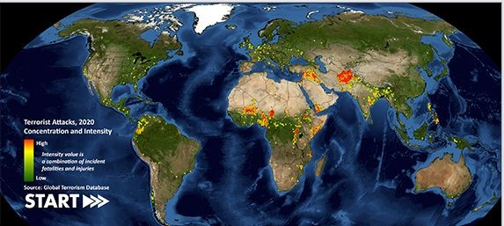
GLOBAL TERRORISM DATABASE
The Global Terrorism Database™ (GTD) is an open-source database including information on terrorist events around the world from 1970 through 2020 (with annual updates planned for the future). Unlike many other event databases, the GTD includes systematic data on domestic as well as international terrorist incidents that have occurred during this time period and now includes more than 200,000 cases.

Slide 4
ATTRIBUTES USED
eventid-Name of the event
iyear-Year of attack
imonth-Month of attack
iday – Day of attack
country_txt –Name of the country
region_txt –Name of the region
provstate-Name of State
latitude-latitude of of terrorist attacked region.
longitude-longitude of terrorist attacked region.
City-Name of attack city
Natly1-Nationality of victim
Attacktype1_txt-Type of terrorist attack
‘

Slide 5
WORK FLOW
1.COLLECTION OF DATA & PROBLEM STATEMENT
2. DATA CLEANING & MANIPULATION
3. EXPLORATION OF DATA ANALYSIS
4. DATA VISUALIZATION
5. OBSERVATION AND CONCLUSION WITH MITIGATION MEASURES

Slide 6
DATA INSPECTION & CLEANING
1.The data set consists of 181691 rows & 135 columns.
2. There are 106 columns in which 135 columns values are missing.
3.After removing 85% missing values we are left with 47 columns.
4. As per need from those 47 columns also, we dropped some columns which were not relevant.
For example-Country column represents name of the country so we have dropped country column which was having numerical representation not relevant.
5. Finally we have 181691 rows & 17 columns for analysis.

Slide 7
1. EXPLORATION OF DATA ANALYSIS
UNIVARIATE ANALYSIS
BIVARIATE ANALYSIS
MULTIVARIATE ANALYSIS

Slide 8
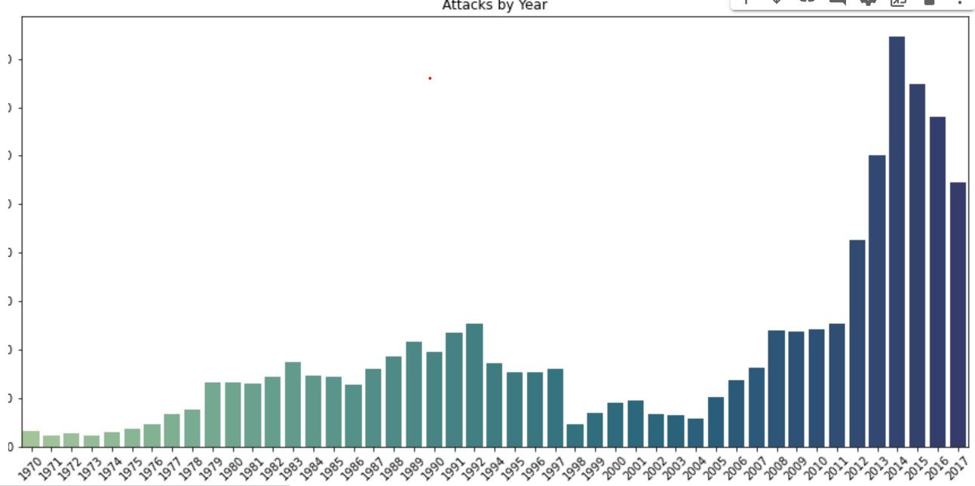
Analysis of Terror attacks year wise

Slide 9
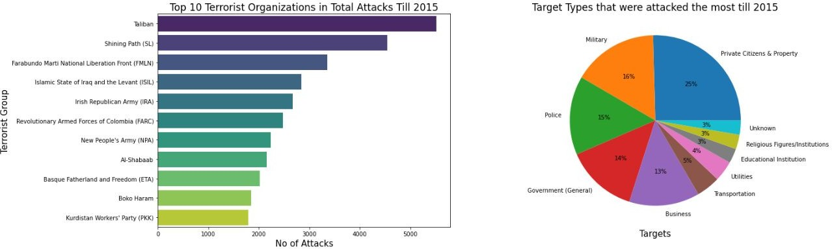
Analysis of Terror attacks in the till 2015

Slide 10
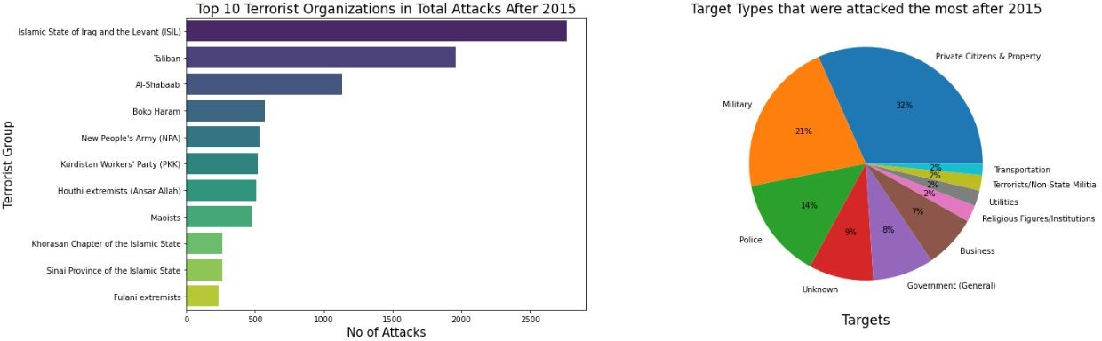
Analysis of Terror attacks after 2015

Slide 11
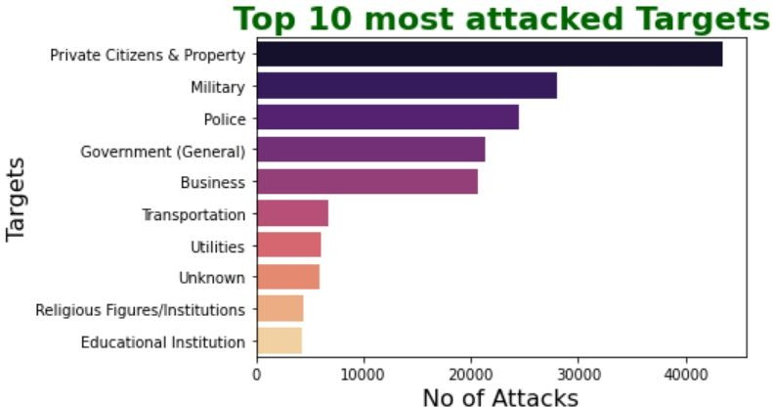
Analysis of Most Target types World wide
Observations :
The most attacked target is 'Private Citizens & Property' which is approximately 25%
Military, Police, Government and Business are of 10-20% attacked Targets

Slide 12
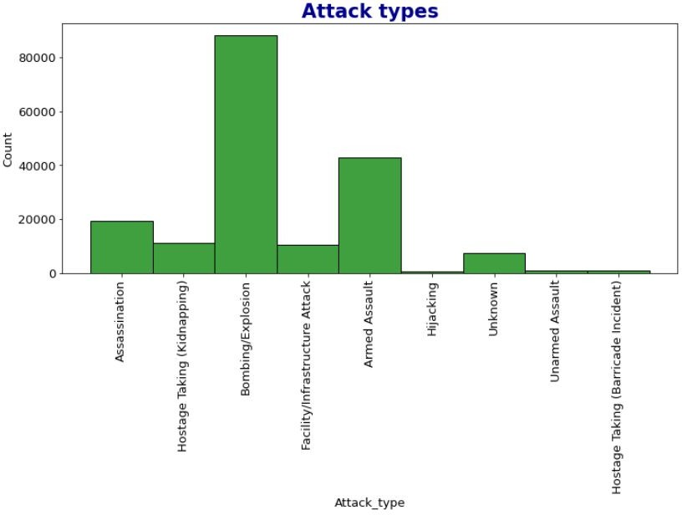
Analysis of Most Attack types World wide
Observations:
50% of the Attacks happened with Bombing/Explosions
10-20% of the Attcks happened with Armed assault and Assassination. Rest are in between 0-6%

Slide 13
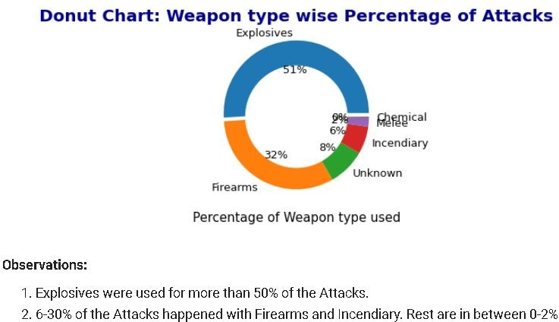
Analysis of Most used Weapon types in Terror attacks

Slide 14
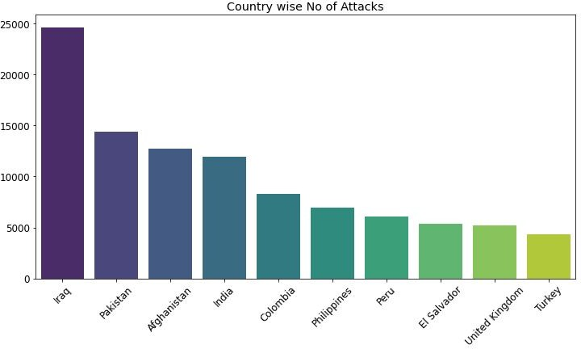
Country wise Terror attacks Analysis

Slide 15
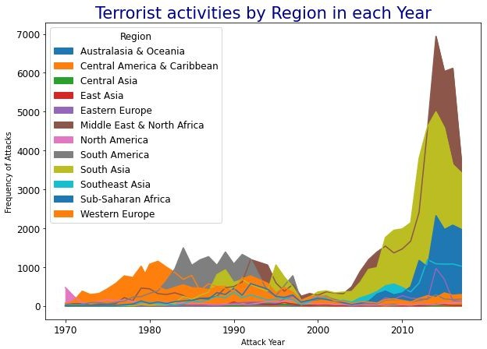
Region wise Terror attacks Analysis

Slide 16
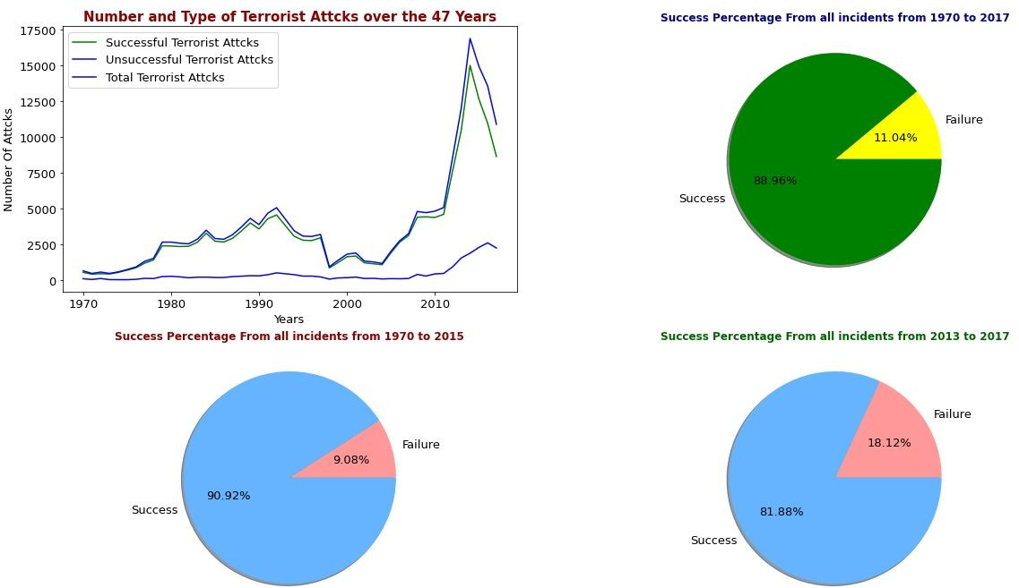
Success/ Failure analysis of Terrorist attacks

Slide 17
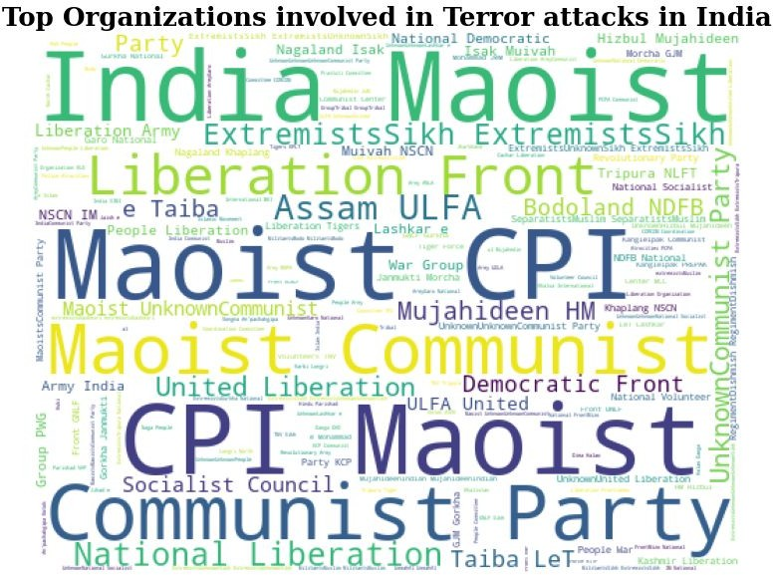
Top Organizations involved in Terror attacks

Slide 18
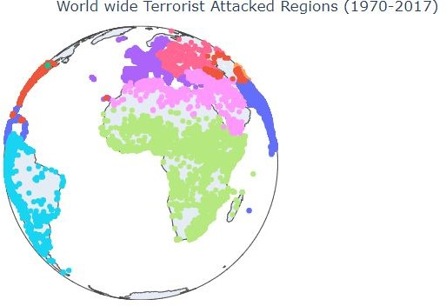

Slide 19
Observations & Conclusions of EDA on Global Terrorism Analysis
1.Terrorist attack's reached a peak during 2014 and then in 2015, started to drop.
2.The middle East & North Africa is the most affected region in terms of the number of terror attacks among all the regions followed by South Asia, South America and Sub-Saharan Africa.
3.Iraq is the most affected nation of all and it has suffered the highest number of attacks followed by Pakistan, Afghanistan and India.
4.Most of the attacks are either bombing or explosions followed by firearms and the most used weapons in the terror attacks are explosives and assault weapons.

Slide 20
Observations & Conclusions of EDA on Global Terrorism Analysis
5.The most active terrorist organisations in the world are Taliban and ISIL and Afghanistan is the country that has suffered the most because of Talibanians.
6.India suffered the highest number of attacks 6 in the year 2016, , peaked during Aug-2016. Most attacks were happened in Srinagar (Jammu & Kashmir). Maoists were responsible for most of the attacks.
7.Terrorist organizations and attacks are slowly moving to underdeveloped and developing countries affecting mostly large populations living below the poverty level in south Asia and Africa.
8.The cycle of terrorism is flourishing as poverty and unemployment help radical ideologists to capture youth towards terrorism, discouraging investors which in turn effects the earnings of governments and leading further to poverty and unemployment.

Slide 21
Mitigation Measures:
Mitigation Measures:
1.Defining terrorism on a global stage and adopting an international framework to tackle terrorism.
2.Creating a joint task force to improve intelligence sharing and sharing the best practices to combat terrorism.
3.Countries should take measures against illegal immigration by implementing better tracking systems.
4.By imposing strict regulations on the access and sale of dangerous weapons and firearms and tracking sources of such weapons.
5.Adopting a global framework and implementing a tough action plan against terror financiers.
6.Education in population control and improving conditions to encourage employment opportunities might reduce terror activities in the long run.
7.Strict policies against disinformation and radicalization need to be adopted, including media & internet.

Slide 22
THANK YOU

